Slide 1

JavaScript: The Language of the Web
Explore the foundational role and enduring impact of JavaScript in shaping the digital world.

Slide 2

The Birth of JavaScript
JavaScript was created by Brendan Eich in 1995 at Netscape in just 10days, At first, it was called Mocha, then changed to LiveScript, and finally named JavaScript. Its main purpose was to make web page interactive, allowing users to do more than just view static content.

Slide 3



Why JavaScript Matters Today
Presence all around
Flexibility
Native Browser Support
Runs on over 98% of websites worldwide, making it an essential skill for web development.
Powers everything from simple animations and interactive forms to complex, dynamic web applications.
JavaScript is the only language that all web browsers can run directly without extra software

Slide 4
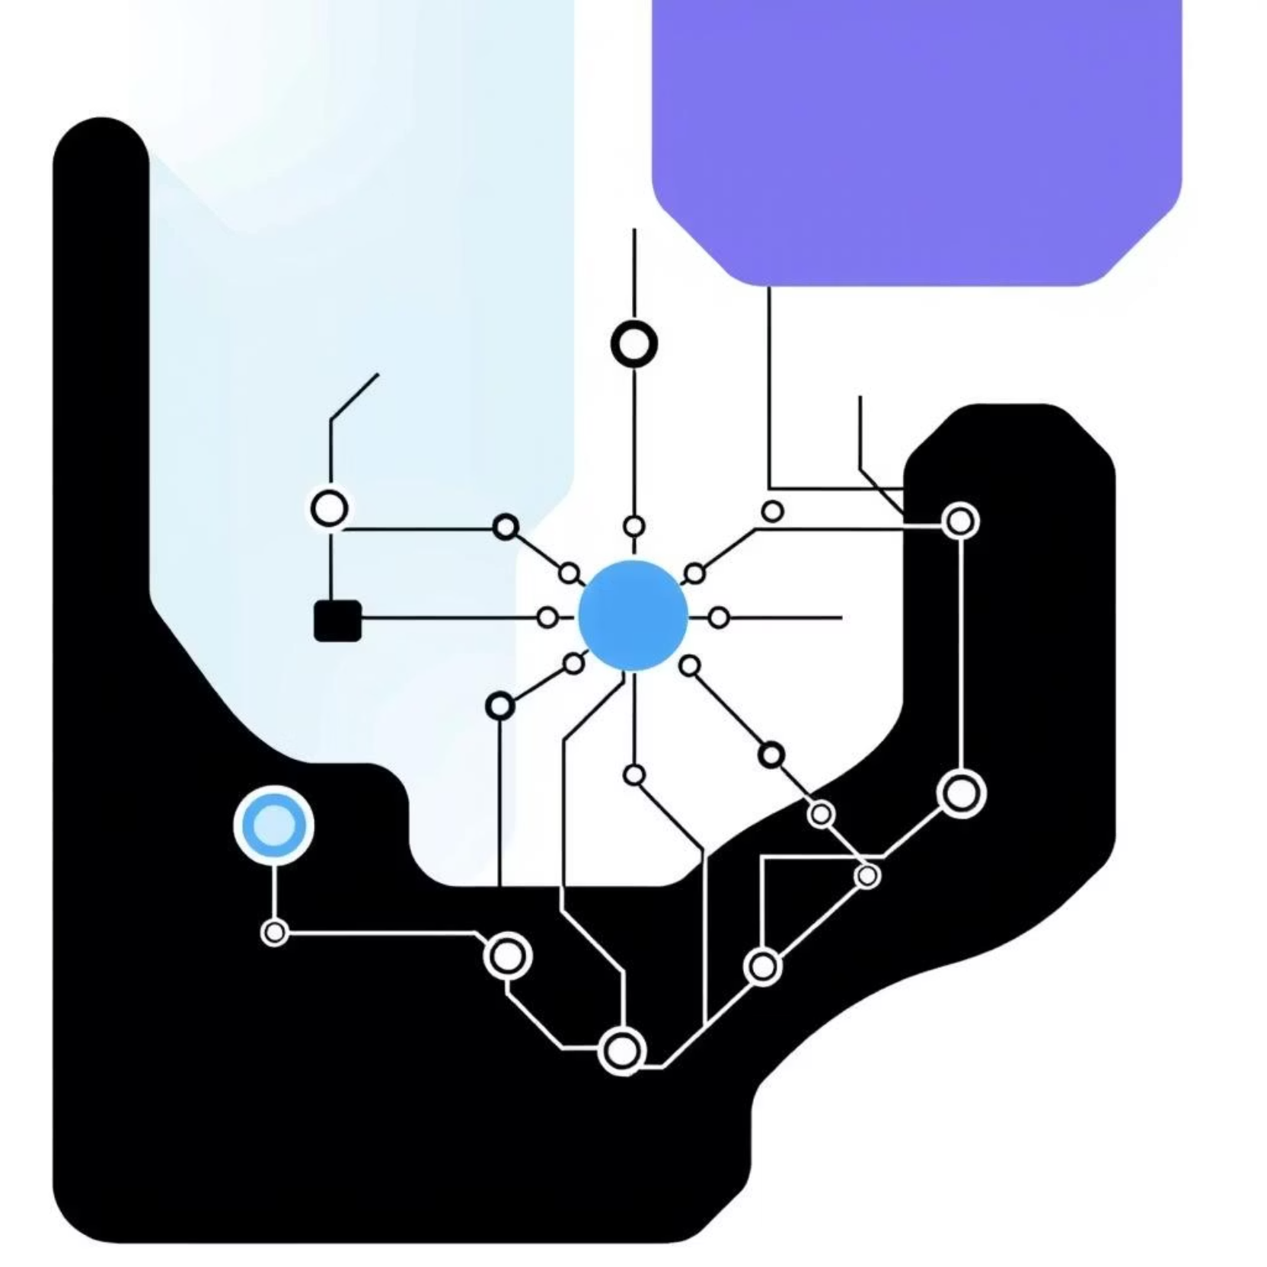
Core JavaScript Concepts
Understanding JavaScript starts with mastering its fundamental building blocks:
Variables, Data Types & Operators: The foundation for storing and manipulating information.
Functions & Scope: Reusable blocks of code that perform specific tasks, managing how data is accessed.
Objects & Arrays: Powerful structures for organizing and managing collections of related data efficiently.

Slide 5




Modern JavaScript Features (ES6+)
Arrow Functions
Promises & Async/Await
Introduced a more concise syntax for writing functions, especially useful for callbacks.
Revolutionized handling asynchronous operations, making complex code easier to read and manage.
Modules
Template Literals
Provided a standardized way to organize and reuse code across different files and projects.
Enabled easier string interpolation and multiline strings with backticks.

Slide 6
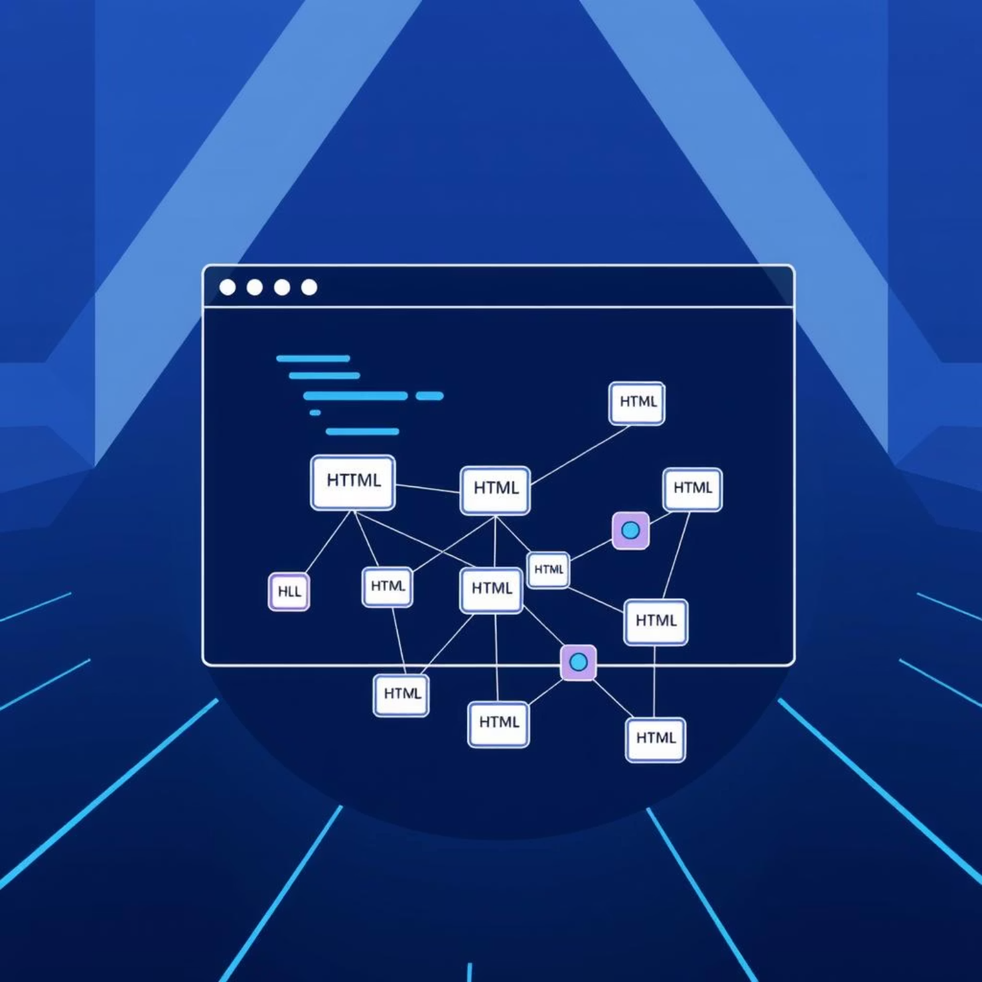
JavaScript and the DOM
The Document Object Model (DOM) is the programming interface for HTML and XML documents. It represents the page so that programs can change the document structure, style, and content.
Manipulating HTML elements dynamically: Change text, attributes, and styles on the fly.
Event handling: Respond to user interactions like clicks, keystrokes, and form submissions.
Example: Create interactive forms, dynamic content updates, and fluid animations that enhance user experience.

Slide 7



JavaScript Beyond the Browser
JavaScript's capabilities extend far beyond the browser, thanks to powerful runtime environments and tools:
Node.js
NPM (Node Package Manager)
Build Tools
A JavaScript runtime that allows you to build scalable server-side applications, powering major services like Netflix and LinkedIn.
Build Tools like Webpack and Babel make development easier by bundling code and adding modern JavaScript features.
The world's largest package ecosystem, boasting over 1.5 million open-source packages ready for use.

Slide 8
Frameworks & Libraries Shaping the Ecosystem
The JavaScript ecosystem thrives on innovative frameworks and libraries that simplify complex development tasks:
1
2
3
UI Development
State Management
Type Safety
React, Angular, and Vue are popular front-end frameworks that make building user interfaces faster and easier.
Redux & Recoil: Solutions for managing application state in large, complex applications, ensuring predictable data flow.
TypeScript: A superset of JavaScript that adds static types, leading to more robust, scalable, and maintainable codebases.

Slide 9

Real-World Impact & Community
JavaScript is powerful and used by all kinds of companies — from small startups to big tech giants like Meta, Google, and Microsoft.
JavaScript has a strong open-source community that keeps improving it. With new ECMAScript updates every year, the language stays modern and relevant.

Slide 10

The Future of JavaScript
Build the Future
Performance & Security
Learning JavaScript today helps you create the interactive and modern web of the future.
Emerging Domains
JavaScript is improving speed and security to support critical applications
Growing role in AI, Web3 (blockchain technologies), and cross-platform mobile applications.

Slide 11

Thank You

